Slide 1

HR ANALYTIC
EMPLOYEE RETENTION

Slide 2

Project Name:
H R Analytics-
Employee Retention
Project Members:
Vrushali Awachat
Sukalaboina Ram Kiran
Veena Rajkumar Tiwari
Chitrala Santosh Kumar

Slide 3
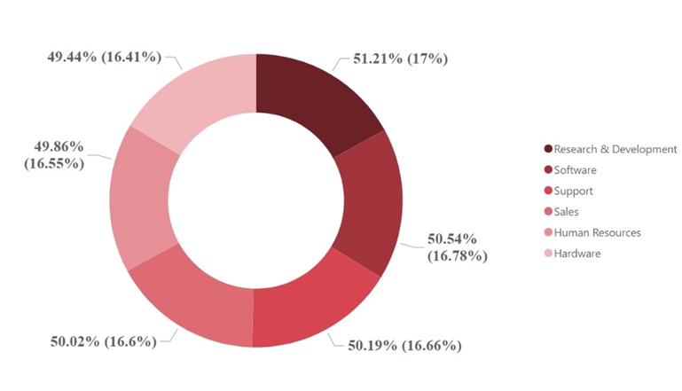
KPI 1 Average Attrition rate for all Departments
which indicates attrition rates of the employees with respect to department as more than 50% of employees already left the organization and almost all departments have more than 50% attrition and highest among all is 'Research and Development' and then software leads.

Slide 4
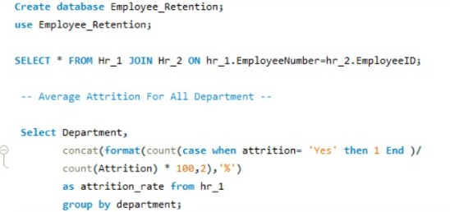
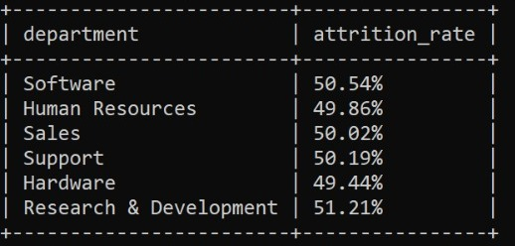
From this calculation and visualisation we did by using MySQL we'll directly get then what are names of department and areas when we need improvement and deep look.

Slide 5
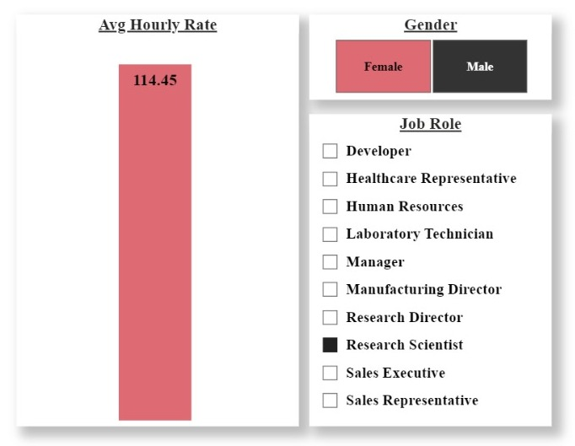
KPI 2
Average Hourly rate of
Male Research Scientist
As we have gender wise two type of employees male and female so with the help of this visualisation we can directly get the idea of Average hourly Rate for employees according to there gender and job role.
This KPI is to find out the average hourly rate of male research scientists which is 114.45.

Slide 6

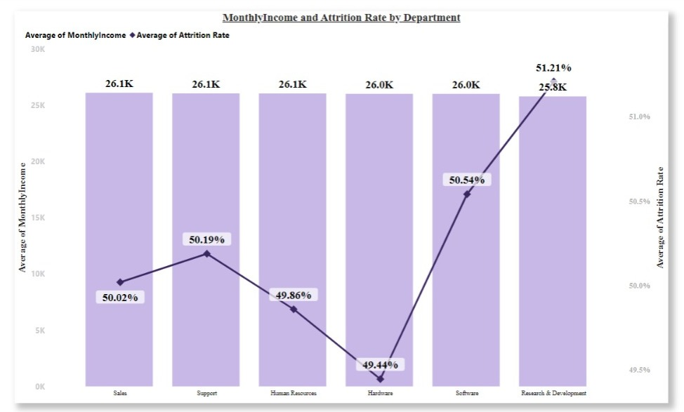
KPI 3 Attrition rate Vs Monthly income stats
This KPI is to find out the relation the between monthly income and Attrition rate.

Slide 7
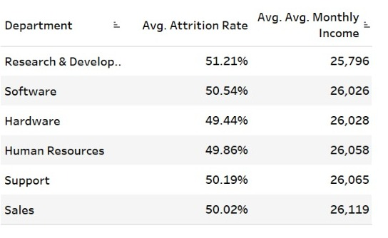
After analyzing and visualizing the data, it is apparent that the attrition rate is the lowest in the Hardware Department at 49.44%.
The employees in this department receive an average monthly income of Rs. 26,091.20.
On the contrary, the Research and Development Department has the highest attrition rate at 51.21%, with an average monthly income of Rs. 26,007.08.
These findings indicate that there is a significant difference in the attrition rates between the two departments, and the employees in the Hardware
Department have a slightly higher average monthly income than those in the Research and Development Department.

Slide 8
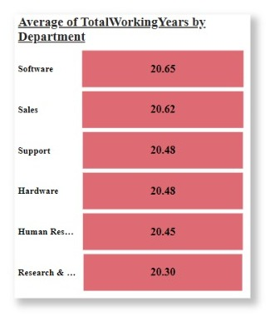
Kpi 4 Average working years for each Department

Slide 9
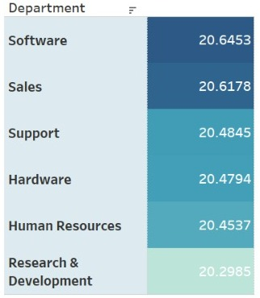
Based on the available information, it appears that the average working years in the Software Department are higher than the other departments.
In contrast, the Research and Development Department has the lowest average working years.
However, we would need to examine the data on working years for each department to confirm this conclusion accurately.
Based on the analysis, it can be inferred that the mean duration of employment across all departments is approximately 20 years.

Slide 10
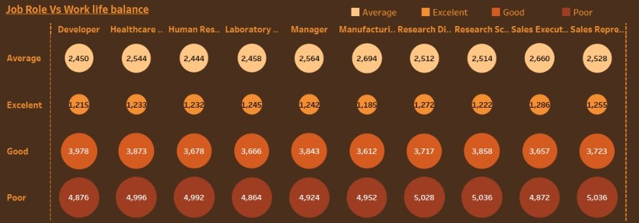
KPI 5 Job Role Vs Work Life Balance
After analyzing the data, it can be concluded that the work-life balance of Research directors and laboratory technicians is poor. This means that they may be struggling to balance their work demands with their personal life and may be experiencing higher levels of stress and burnout.

Slide 11
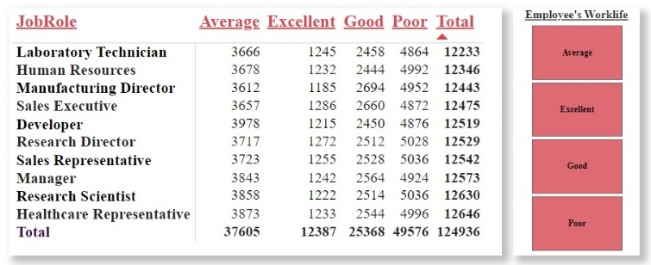

Slide 12
On the other hand, Sales representatives, managers, Manufacturing Directors, and Sales executives report a fair work-life balance.
This implies that they are able to manage their work demands and personal commitments to a certain extent, but may still experience occasional difficulties in finding a good balance.
In contrast, the work-life balance of Research Scientists, Healthcare representatives, and Developers is rated as good, indicating that they generally have more control over their workload and are able to manage their personal commitments with work demands relatively well.
Lastly, the analysis suggests that employees in the human resources department have an excellent work-life balance.
This implies that they are able to manage their work demands in a way that allows them to maintain a healthy work-life balance, which can contribute to their overall job satisfaction and well-being.

Slide 13
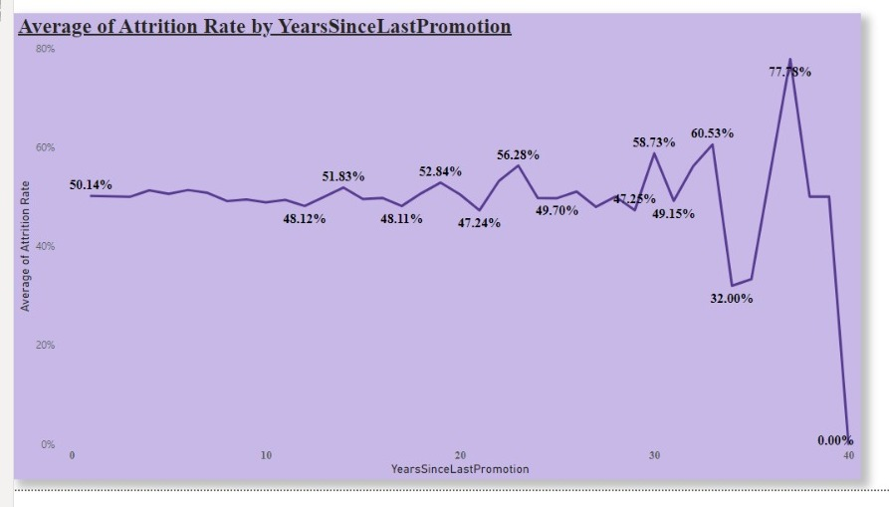
KPI 6
Attrition rate Vs Year since last Promotion
Based on the analysis and visualization of the data, the following can be concluded regarding the attrition rate of different departments across various promotion intervals.

Slide 14
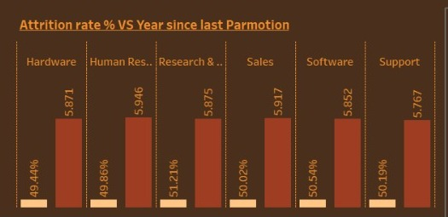
For employees who have been promoted within the last 0-5 years, the Research & Development department has the highest attrition rate, while the Hardware department has the lowest attrition rate.
For employees who have been promoted within the last 6-10 years, the Human resources department has the highest attrition rate, while the Software department has the lowest attrition rate.
For employees who have been promoted within the last 11-15 years, the Support department has the highest attrition rate, while the Sales department has the lowest attrition rate.
For employees who have been promoted within the last 16-20 years, the Software department has the highest attrition rate, while the Hardware department has the lowest attrition rate.
For employees who have been promoted within the last 21-25 years, the Software department has the highest attrition rate, while the Support department has the lowest attrition rate.
In summary, the attrition rate varies across different departments and promotion intervals, with some departments experiencing higher attrition rates compared to others.
For employees who have been promoted within the last 26-30 years, the Support department has the highest attrition rate, while the Human resources department has the lowest attrition rate.
For employees who have been promoted more than 30 years ago, the Software department has the highest attrition rate, while the Human resources department has the lowest attrition rate.

Slide 15
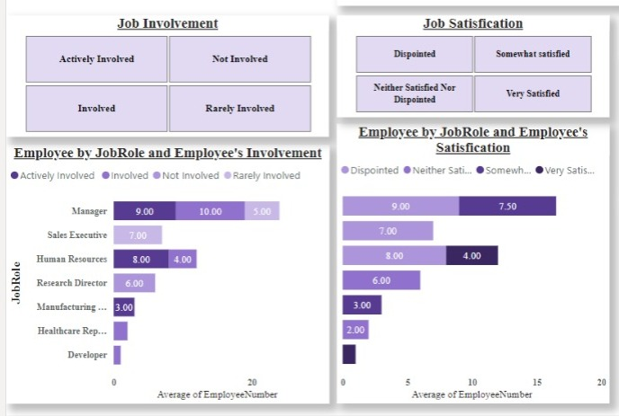
Kpi 7 Job satisfaction and job involvement = organizational commitment Job satisfaction and job involvement can certainly help to reduce attrition, as both of these factors are closely linked to employee retention.

Slide 16
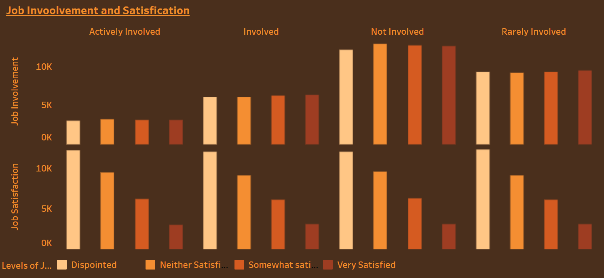
Job satisfaction refers to an employee's overall feelings about their job, including factors such as pay, work environment, management, and career development opportunities. When employees are satisfied with their job, they are more likely to feel committed to their employer and to stay with the organization.
Job involvement, on the other hand, refers to the degree to which an employee feels connected to their job and engaged in their work. When employees are highly involved in their job, they are more likely to feel a sense of purpose and fulfillment, which can lead to greater job satisfaction and ultimately reduce the likelihood of attrition.
In combination, job satisfaction and job involvement can create a positive cycle where employees are more likely to stay with the organization and be productive and engaged in their work, which in turn can lead to even greater job satisfaction and involvement.

Slide 17
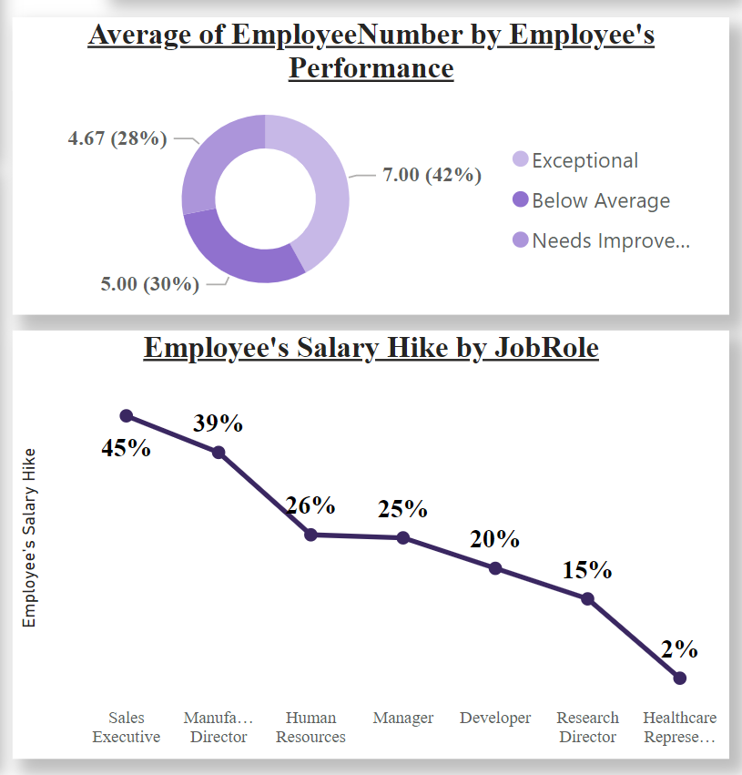
Kpi 8 Employee’s performance and salary hike
Employee performance and salary hike can have a significant impact on attrition, as they are closely related to an employee's job satisfaction and motivation.
When employees feel that their performance is not being adequately recognized or rewarded, they may become disengaged and start to look for other job opportunities. Similarly, if employees feel that their salary is not competitive with industry standards or not commensurate with their skills and experience, they may also be more likely to leave the organization.

Slide 18
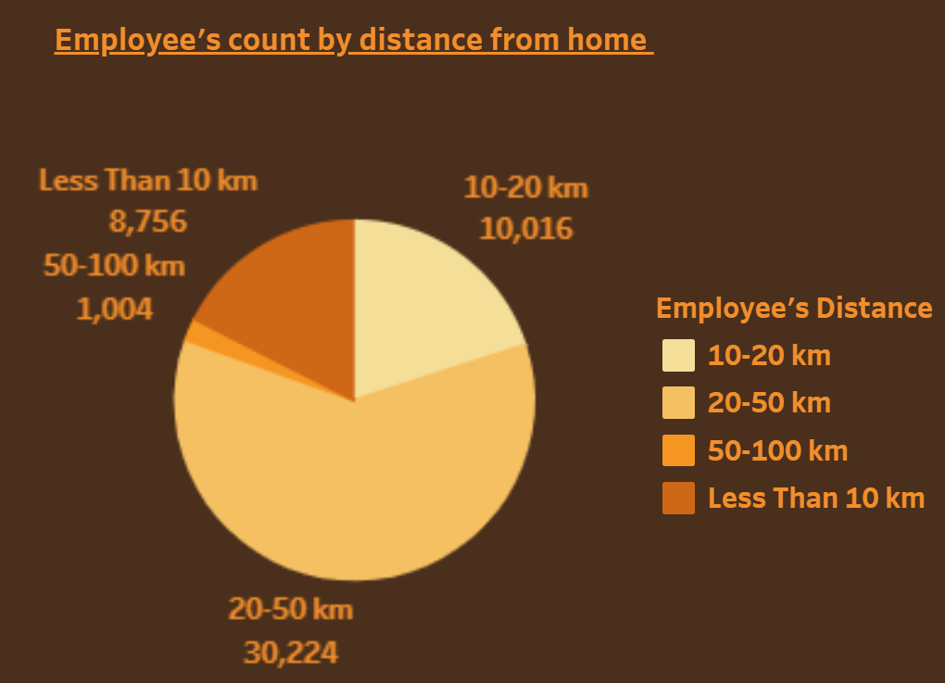
Kpi 9 Distance from home
Distance from home can certainly affect the attrition rate of employees, as it can impact their work-life balance and overall job satisfaction.
When employees have to commute long distances to work, they may experience increased stress and fatigue, which can affect their productivity and job performance. Additionally, longer commutes can take away from the time employees have to spend with their families and engage in other activities outside of work. Over time, these factors can lead to burnout and a decreased sense of job satisfaction.

Slide 19
Conclusion
To increase employee engagement, organizations can take steps to implement initiatives that foster a positive work environment and promote employee satisfaction. This can include providing regular feedback to employees, recognizing and rewarding their contributions, and offering opportunities for career growth and development.
Organizations can promote employee well-being, job satisfaction, and productivity. By taking a proactive approach to workload management, organizations can help prevent employee turnover and ensure that employees feel supported and valued in their roles.
To promote employee retention, organizations must address pay and compensation issues. This involves ensuring that employees receive fair compensation for their work, and taking steps to understand what motivates employees to continue working for the organization.
Additionally, by understanding what motivates employees, organizations can tailor their compensation and incentive programs to promote employee satisfaction and retention.
By addressing pay and compensation issues, organizations can create a work environment that fosters employee loyalty, productivity, and long-term retention.

Slide 20
Thank You

